Slide 1
CS 580 – Discussion Hw2 Rasterization
Week 2
Lixing Liu
lixing.liu@usc.edu

Slide 2
Reminder: HW1
Due Tue, Aug 28 (tonight)
Note: if you installed VS 2015 Update 2, you’ll have .VC.db file (e.g., “CS580HW1.VC.db”) instead of .sdf file (e.g., “CS580HW1.sdf”)
* Please delete those files before submitting your assignment to BB

Slide 3
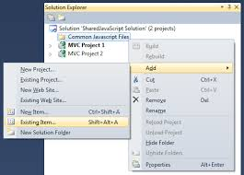
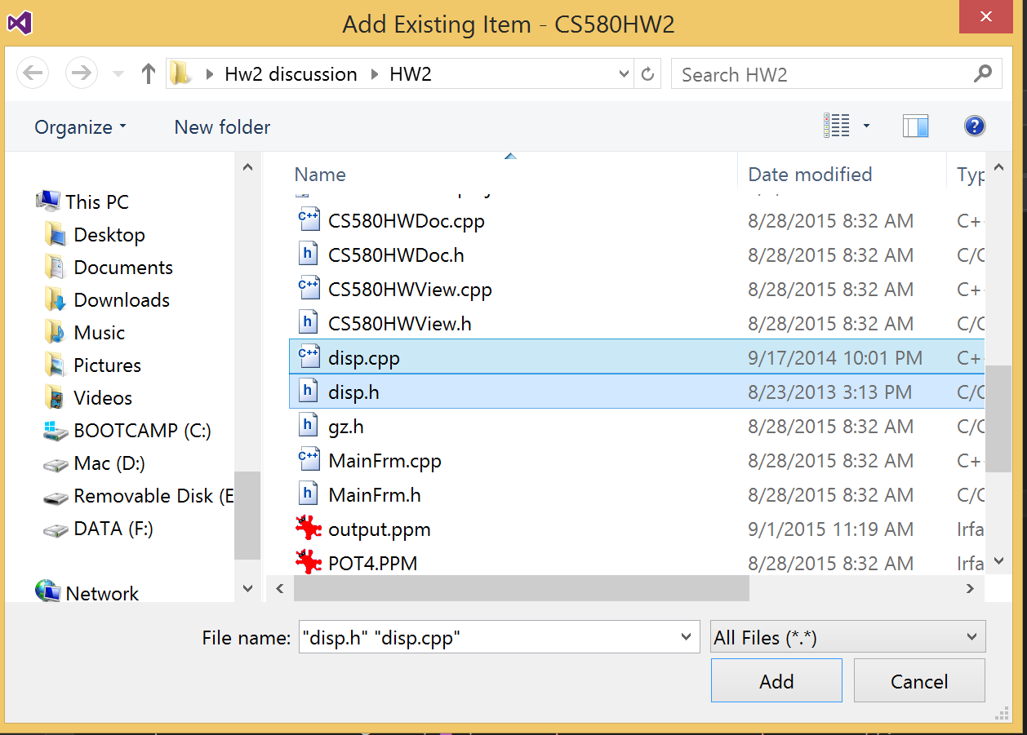
How to compile Hw2
Download Hw2.zip from blackboard
Unzip the file and Open .dsw file
Copy rend.cpp + rend.h from HW1
Add existing item (Shift + Alt + A)
Select rend.cpp + rend.h
Build Solution
Your renderer will link with your display code from HW1. If your display code is not yet correct, you'll have to complete it since you need it now.

Slide 4
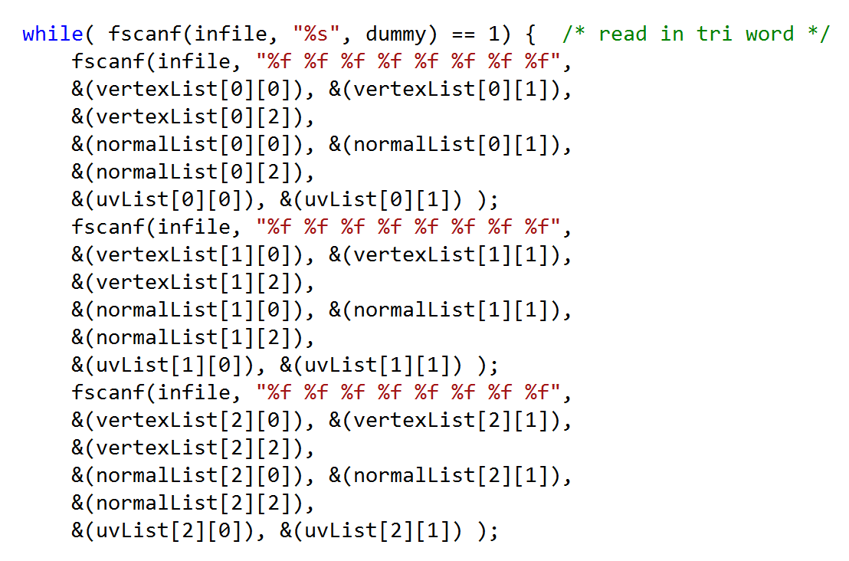
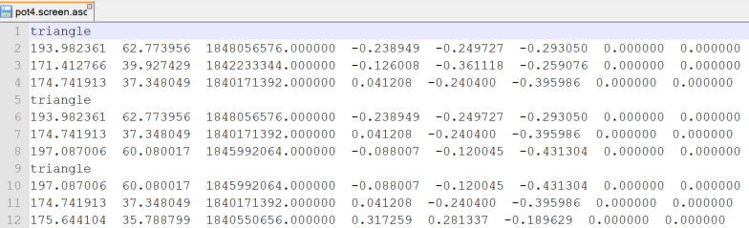
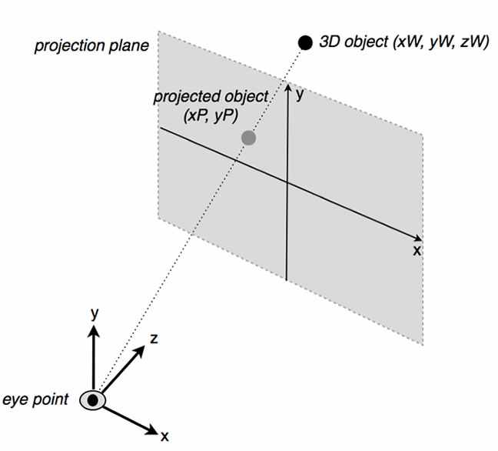
Input file
Application2.cpp
#define INFILE2 "pot4.screen.asc“
Tris are pre-transformed into screen coordinates for HW2
Input file has tris with X,Y,Z ready for rasterization
v1
X, Y, Z, Nx, Ny, Nz, U, V
v2
v3

Slide 5
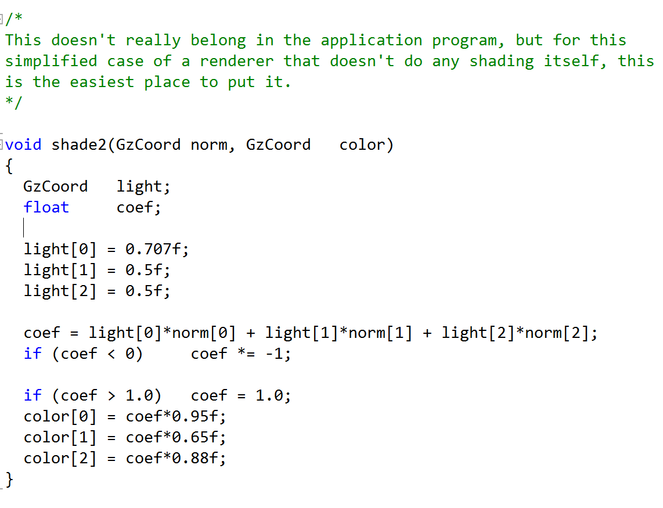
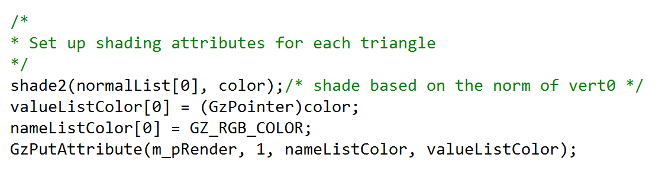
Input file
Application2.cpp
#define INFILE2 "pot4.screen.asc“
Color is assigned for each tri
X, Y, Z, Nx, Ny, Nz, U, V

Slide 6
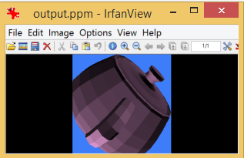
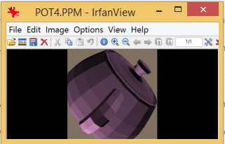
Output
The result images are made into a 256x256 window.
Do not change the resolution/size of your display image since the transformation is precomputed for that image size.
#define OUTFILE2 "output.ppm"
You can compare the result with POT4.PPM

Slide 7
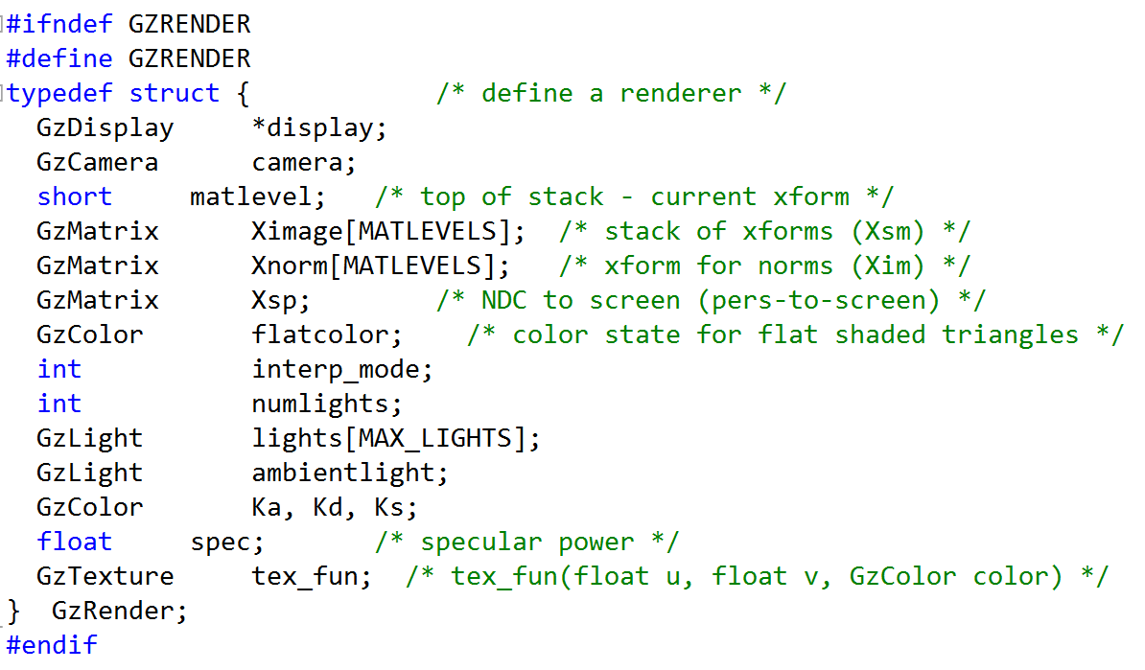
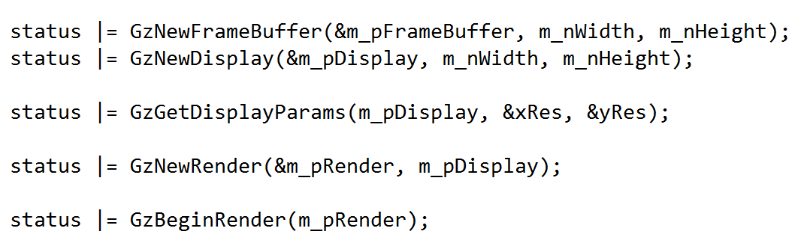
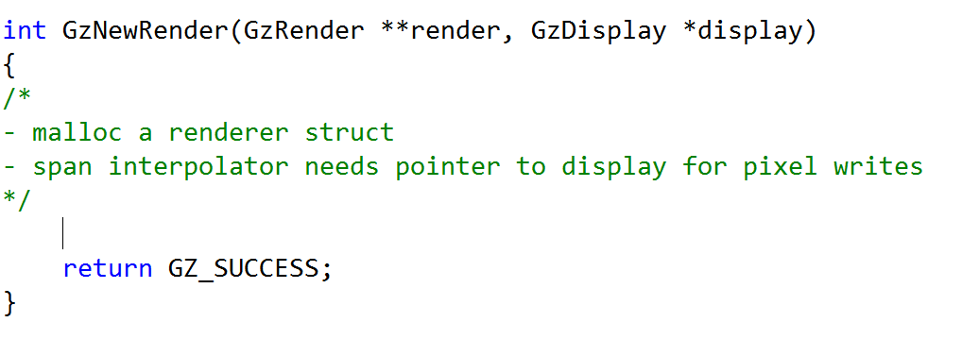
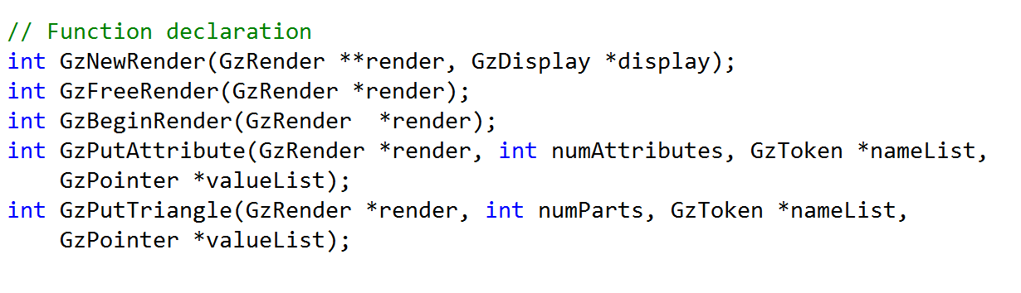
Render – 1. GzNewRender()
The renderer has to manage the display
Application2.cpp
render.h
render.cpp
You’ll need to implement theses functions

Slide 8
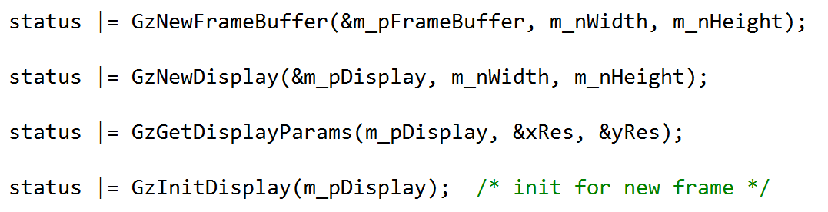
Render – 2. GzBeginRender()
GzBeginRender() is called to initialize everything for a new frame
render.h
Application1.cpp
Application2.cpp

Slide 9
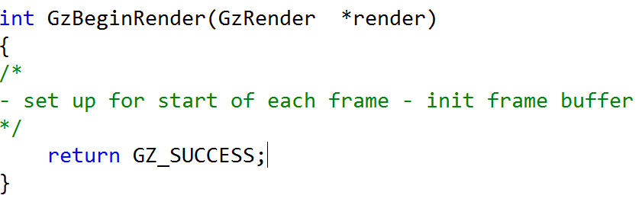
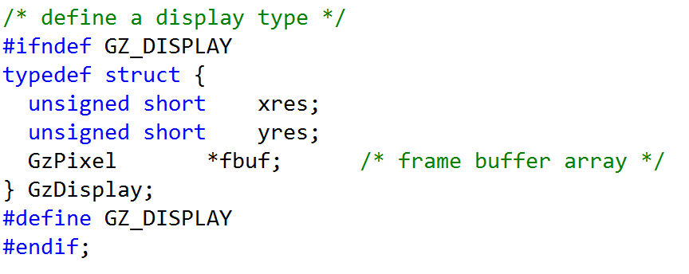
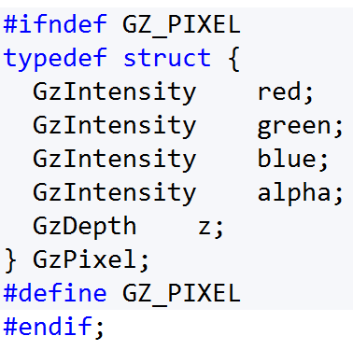
Modify rend.cpp if needed
render.h
rend.h
int GzInitDisplay(GzDisplay*display)
The renderer must do z-buffering so you need to initialize z in its framebuffer, in addition to setting the background color
Initial z-value is MAXINT, the maximum positive integer value
int GzPutDisplay(GzDisplay *display, int i, int j, GzIntensity r, GzIntensity g, GzIntensity b, GzIntensity a, GzDepth z)
If you did not set z value in Hw1

Slide 10

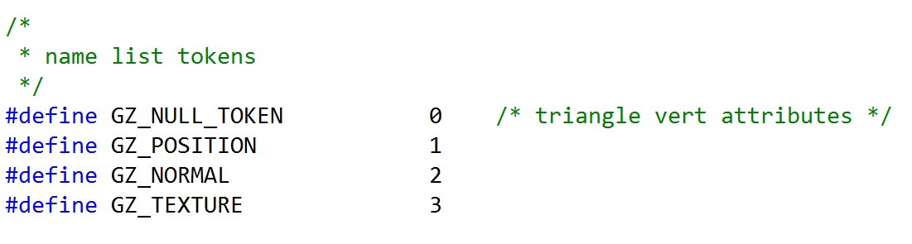
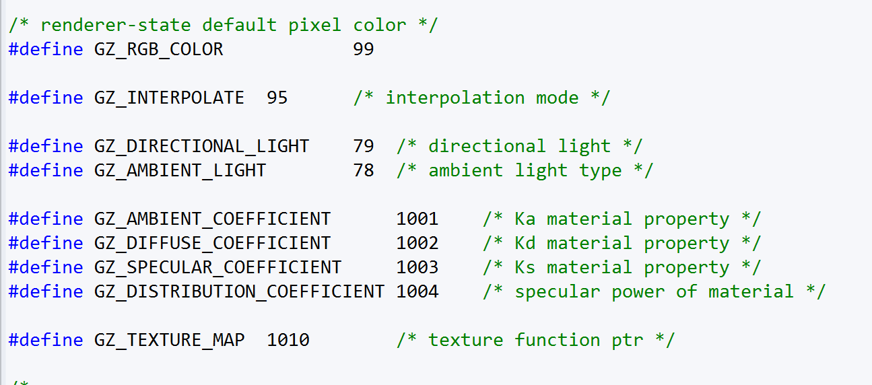
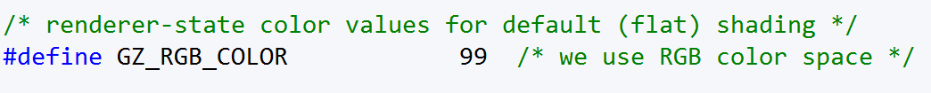
Tokens and Values
gz.h
int GzPutAttribute (GzRender *render, int numAttributes, GzToken *nameList, GzPointer *valueList)
List of Tokens (ints) List of values
GZ_RGB_COLOR Float Color [3]
….. …..
Only use GZ_RGB_COLOR for HW2, but other data will be passed in later HWs
Increment through tokens (ints) and use (sizeof) token type to increment the pointer through the value list
Application2.cpp
gz.h (hw6)
gz.h

Slide 11
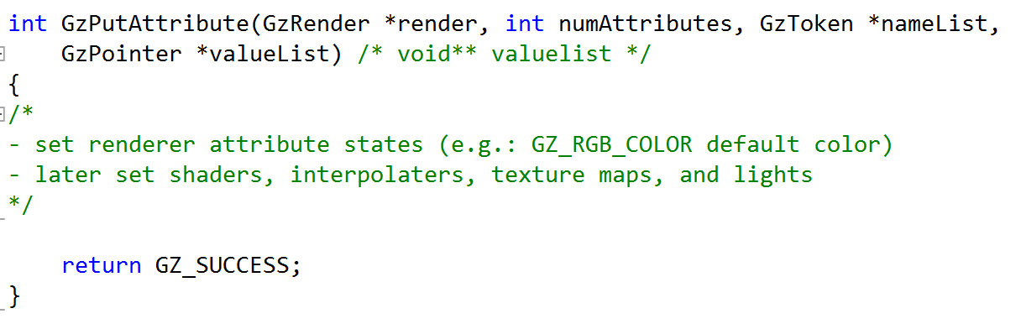
Render – 3. GzPutAttribute
Application2.cpp
A simple shading function is within the application and it computes a color for each triangle
Color is sent to renderer via the generic GzPutAttribute() call that uses pointers to a token list and value list
Color is passed to Renderer as RGB array of floats defined over the range [0.0, 1.0]
render.h
render.cpp

Slide 12
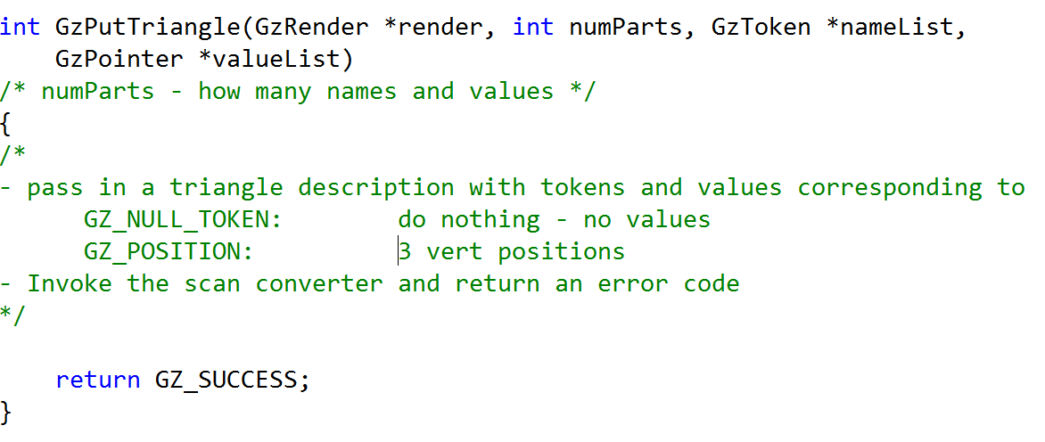
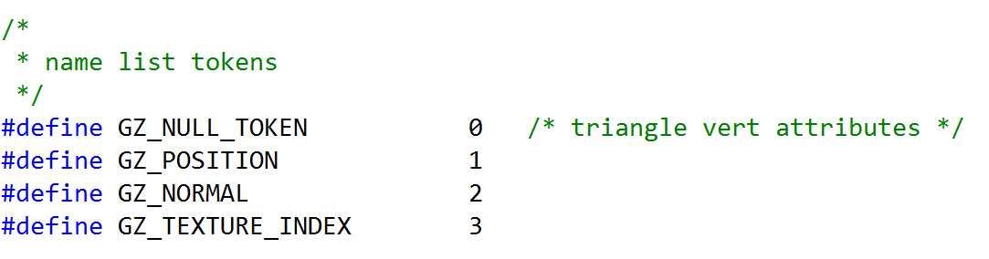
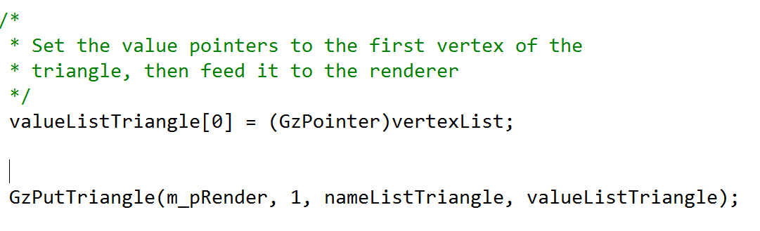
Render – 4. GzPutTriangle
Same as GzPutAttribute function – only use GZ_POSITION token right now – no other triangle data for HW2
Rasterization
LEE or Scan Line(DDA)
Application2.cpp
v1
v2
v3

Slide 13
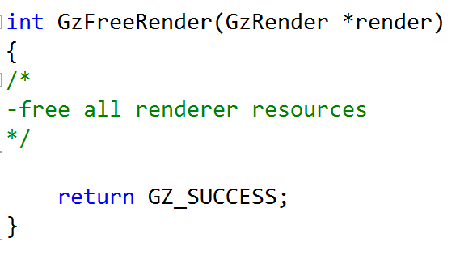
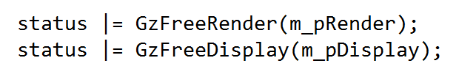
Render – 5. GzFreeRender
Do not free dispay in GzFreeRender()
render.h
Application2.cpp

Slide 14
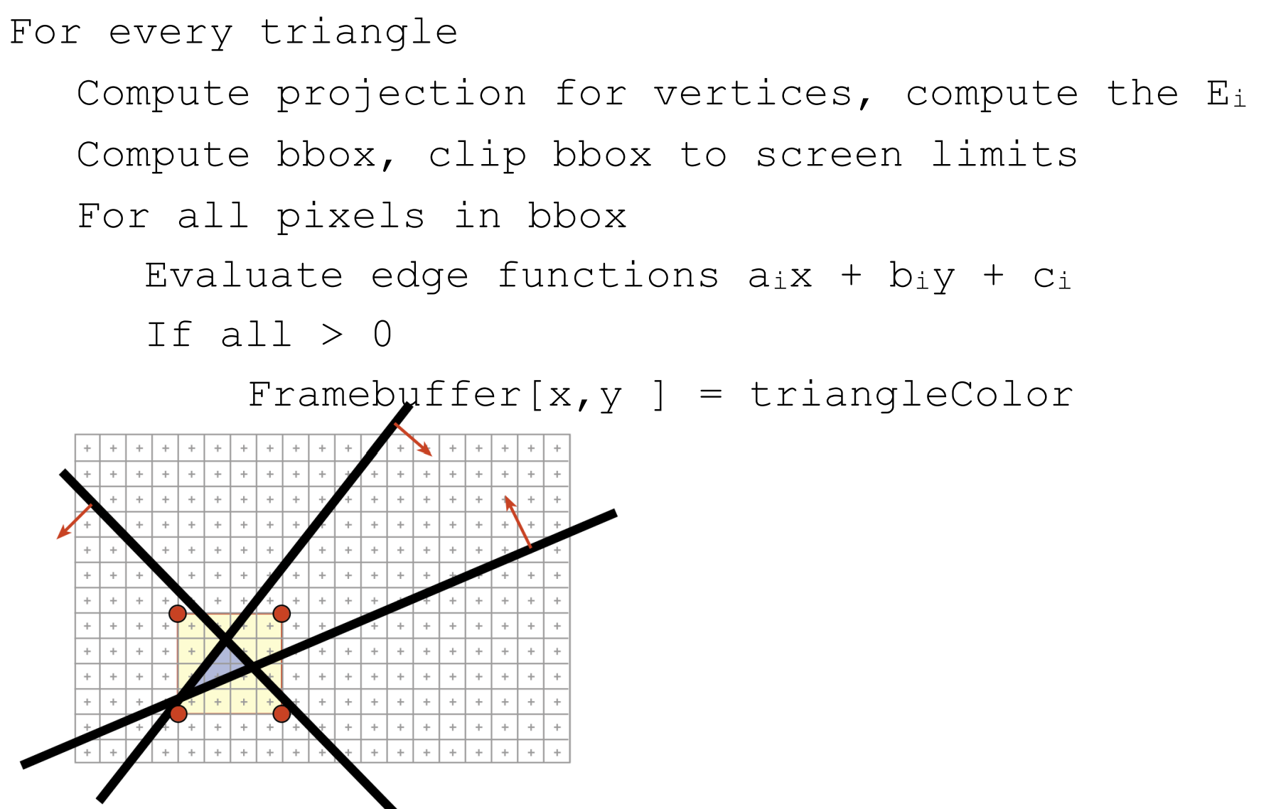
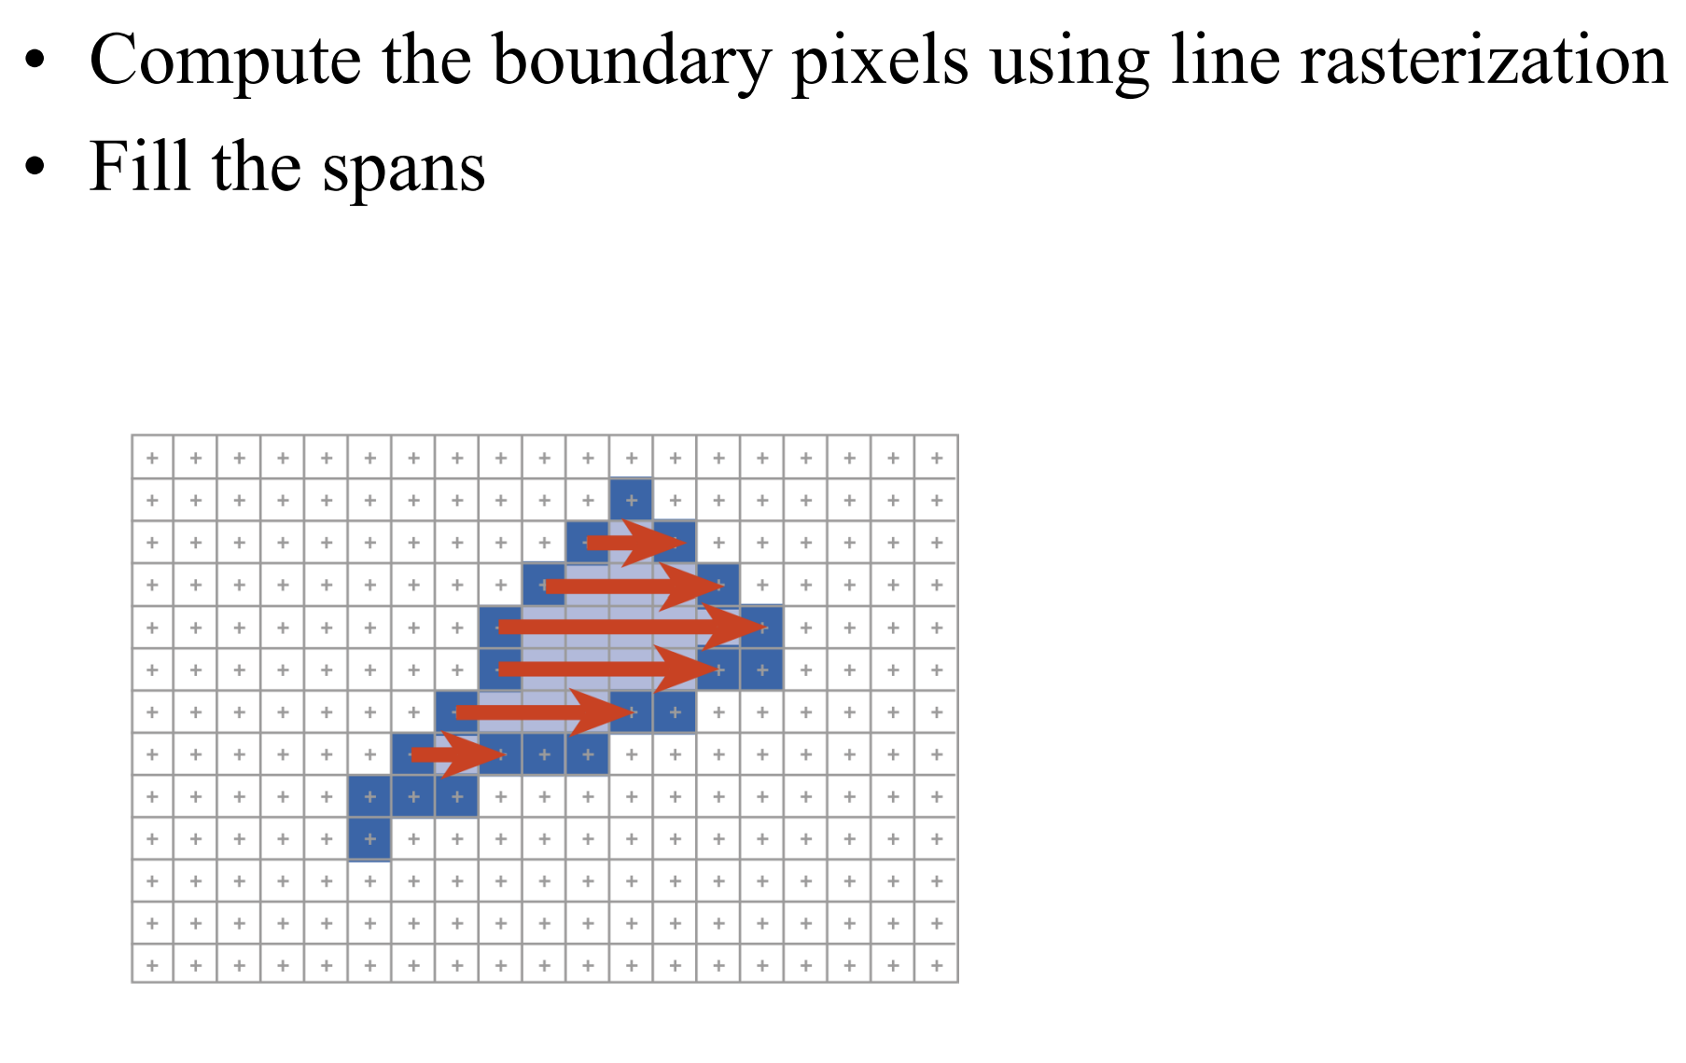
LEE or Scan Line(DDA)
More information for rasterization method
http://ocw.mit.edu/courses/electrical-engineering-and-computer-science/6-837-computer-graphics-fall-2012/lecture-notes/MIT6_837F12_Lec21.pdf
LEE – P.57
Scan Line – P.68

